Slide 1

Chapter 23
Electric Potential
PowerPoint® Lectures for
University Physics, Thirteenth Edition
– Hugh D. Young and Roger A. Freedman
Lectures by Wayne Anderson

Slide 2
Goals for Chapter 23
To calculate the electric potential energy of a group of charges
To know the significance of electric potential
To calculate the electric potential due to a collection of charges
To use equipotential surfaces to understand electric potential
To calculate the electric field using the electric potential

Slide 3

Introduction
How is electric potential related to welding?
Electric potential energy is an integral part of our technological society.
What is the difference between electric potential and electric potential energy?
How is electric potential energy related to charge and the electric field?

Slide 4
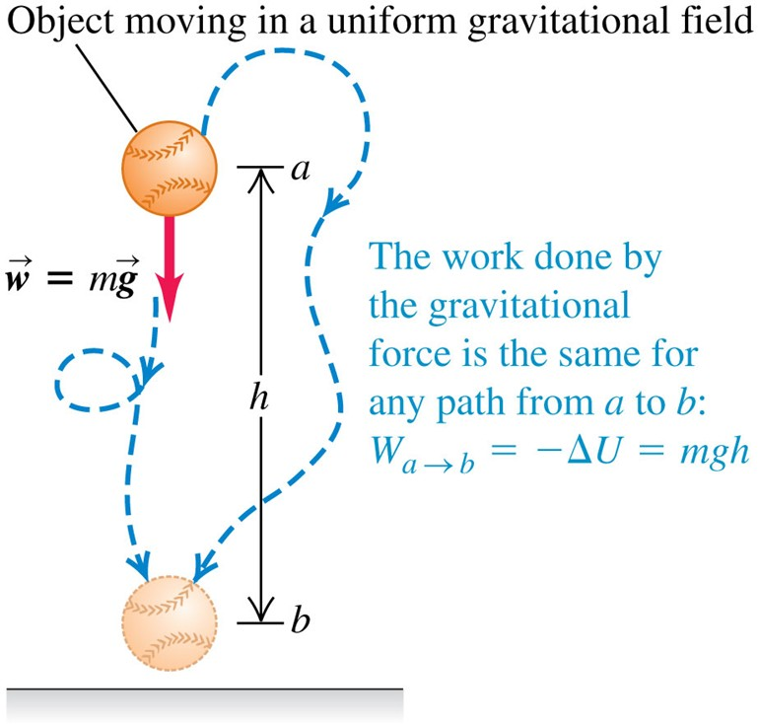
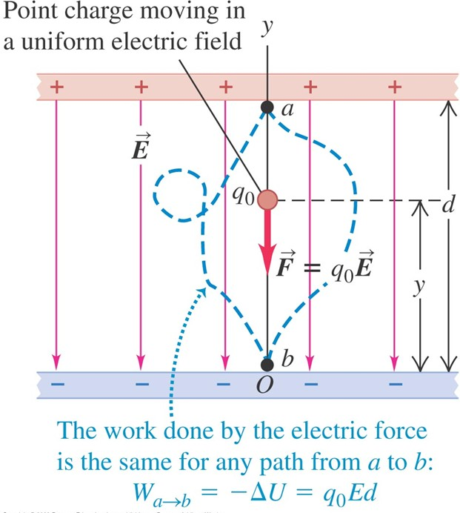
Electric potential energy in a uniform field
The behavior of a point charge in a uniform electric field is analogous to the motion of a baseball in a uniform gravitational field.
Figures 23.1 and 23.2 below illustrate this point.

Slide 5
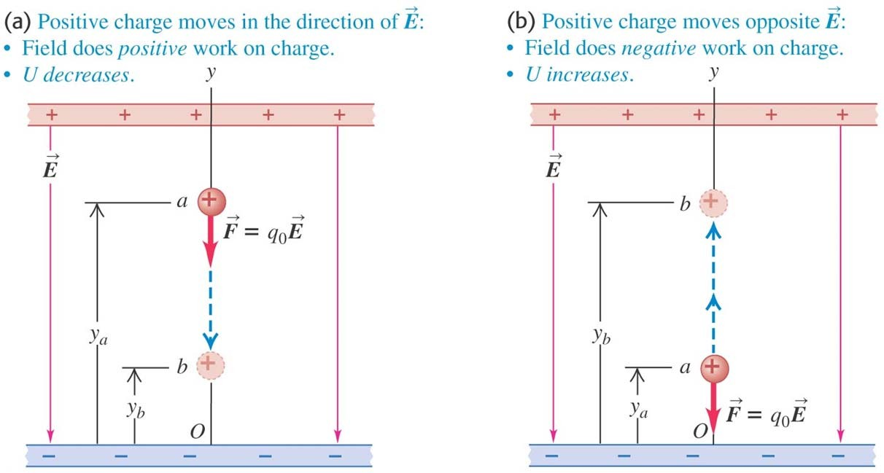
A positive charge moving in a uniform field
If the positive charge moves in the direction of the field, the potential energy decreases, but if the charge moves opposite the field, the potential energy increases.
Figure 23.3 below illustrates this point.

Slide 6
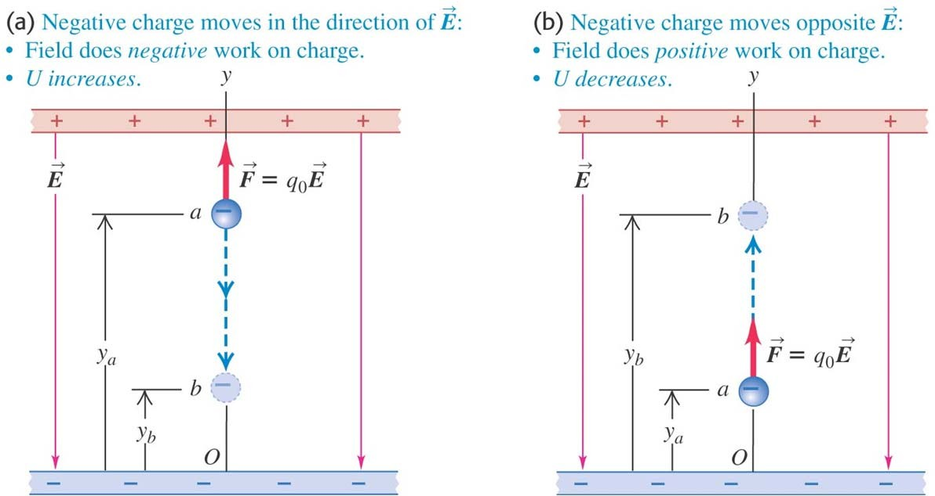
A negative charge moving in a uniform field
If the negative charge moves in the direction of the field, the potential energy increases, but if the charge moves opposite the field, the potential energy decreases.
Figure 23.4 below illustrates this point.

Slide 7
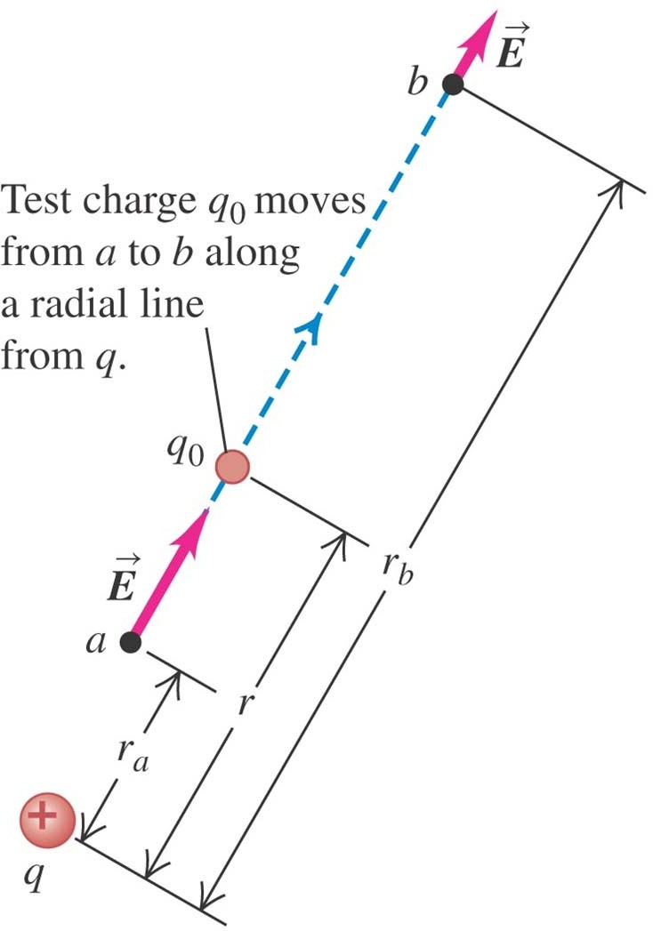
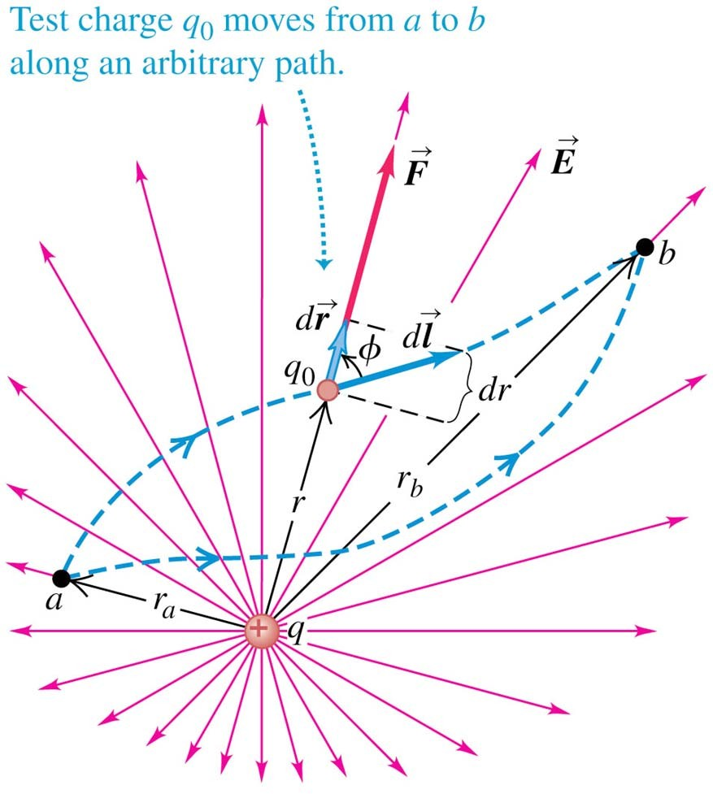
Electric potential energy of two point charges
Follow the discussion of the motion of a test charge q₀ in the text.
The electric potential is the same whether q₀ moves in a radial line (left figure) or along an arbitrary path (right figure).

Slide 8
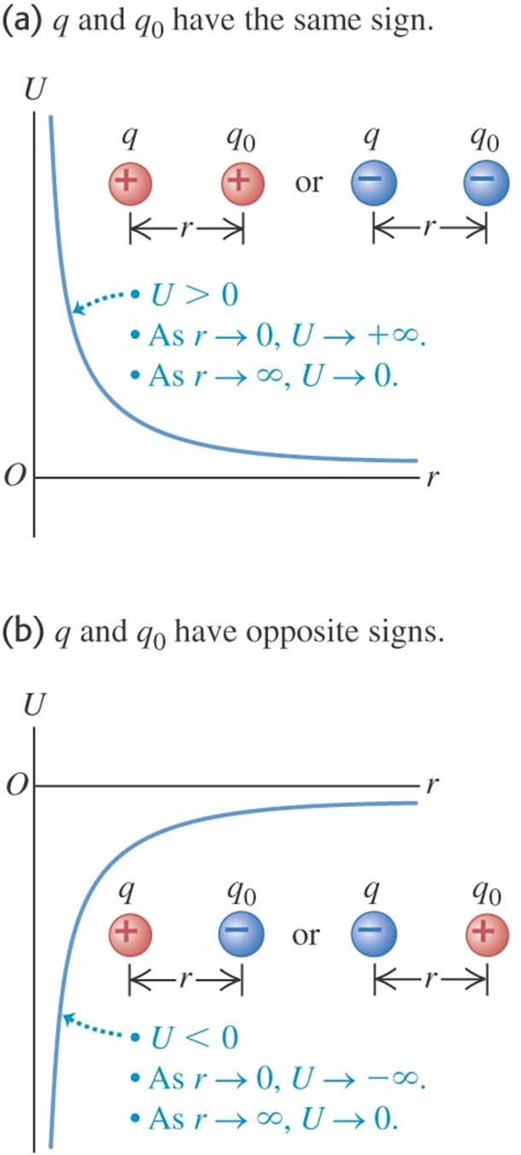
Graphs of the potential energy
The sign of the potential energy depends on the signs of the two charges.
See Figure 23.7 at the right.
Follow Example 23.1.

Slide 9
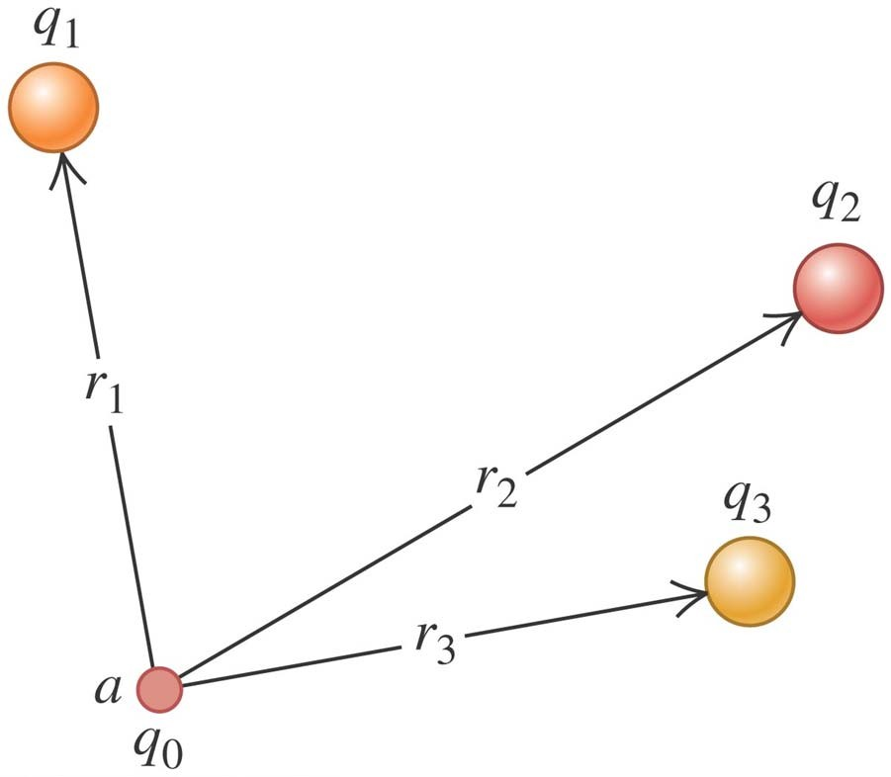
Electrical potential with several point charges
The potential energy associated with q₀ depends on the other charges and their distances from q₀, as shown in Figure 23.8 at the right.
Follow the derivation in the text of the formula for the total potential energy U.
Follow Example 23.2.

Slide 10
Electric potential
Potential is potential energy per unit charge.
We can think of the potential difference between points a and b in either of two ways. The potential of a with respect to b (V_{ab} = V_{a} – V_{b}) equals:
the work done by the electric force when a unit
charge moves from a to b.
the work that must be done to move a unit charge slowly from b to a against the electric force.
Follow the discussion in the text of how to calculate electric potential.

Slide 11
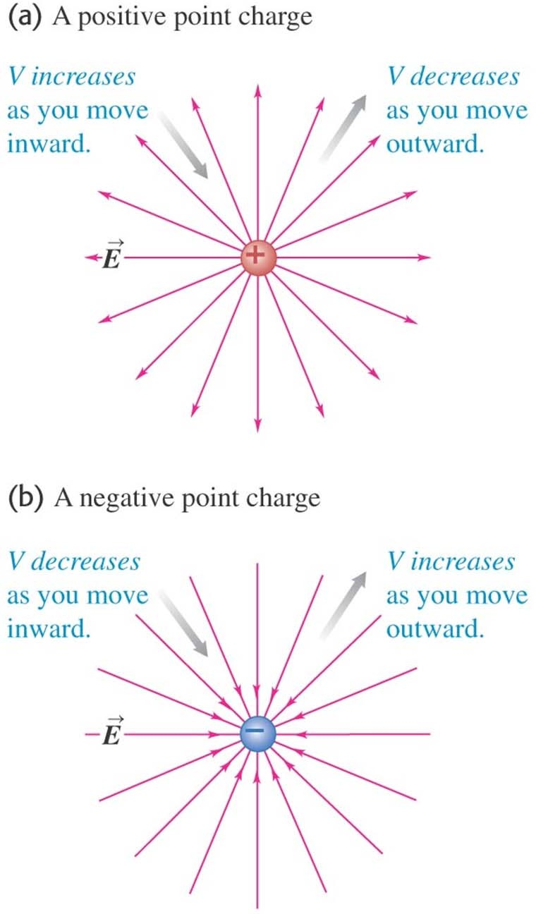
Finding electric potential from the electric field
If you move in the direction of the electric field, the electric potential decreases, but if you move opposite the field, the potential increases. (See Figure 23.12 at the right.)
Follow the discussion in the text.
Follow Example 23.3.

Slide 12
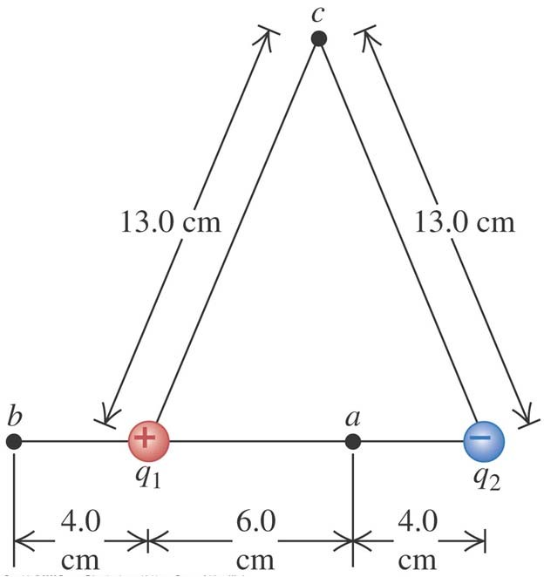
Potential due to two point charges
Follow Example 23.4 using Figure 23.13 at the right.
Follow Example 23.5.

Slide 13
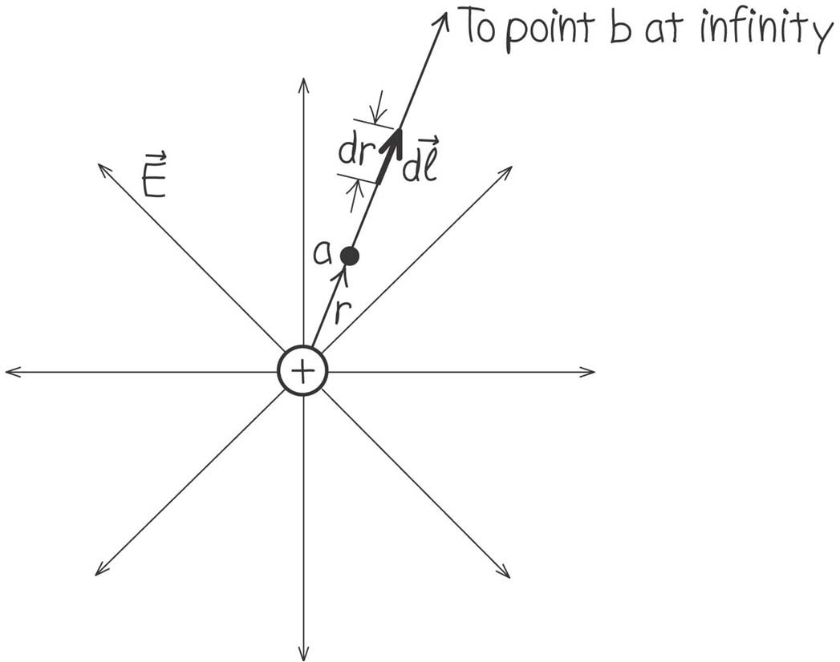
Finding potential by integration
Example 23.6 shows how to find the potential by integration. Follow this example using Figure
23.14 at the right.

Slide 14
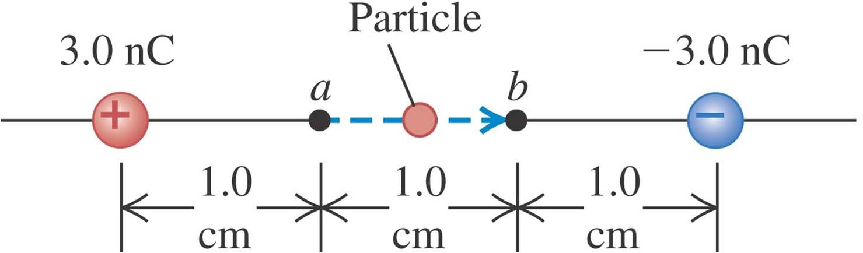
Moving through a potential difference
Example 23.7 combines electric potential with energy conservation. Follow this example using Figure 23.15 below.

Slide 15
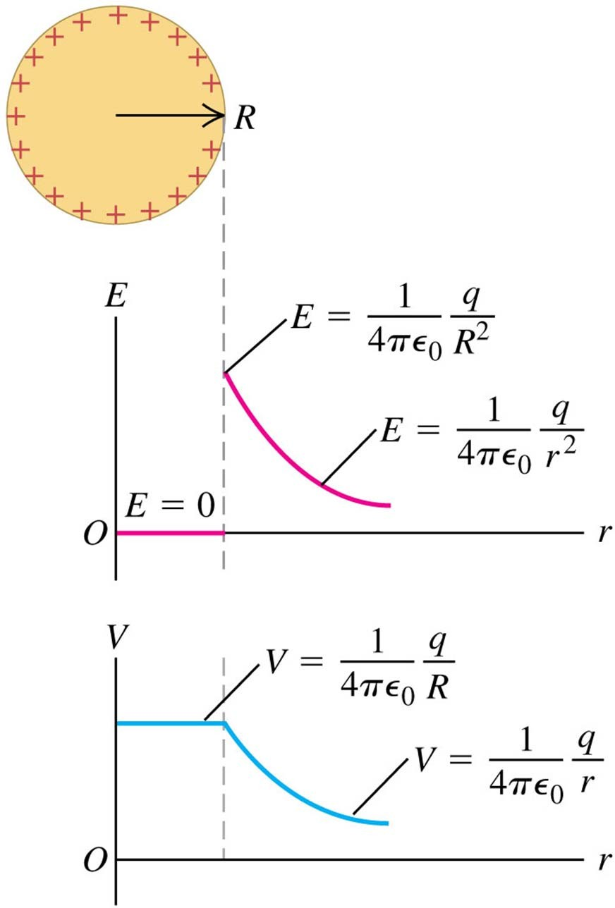
Calculating electric potential
Read Problem-Solving Strategy 23.1.
Follow Example 23.8 (a charged conducting sphere) using Figure
23.16 at the right.

Slide 16
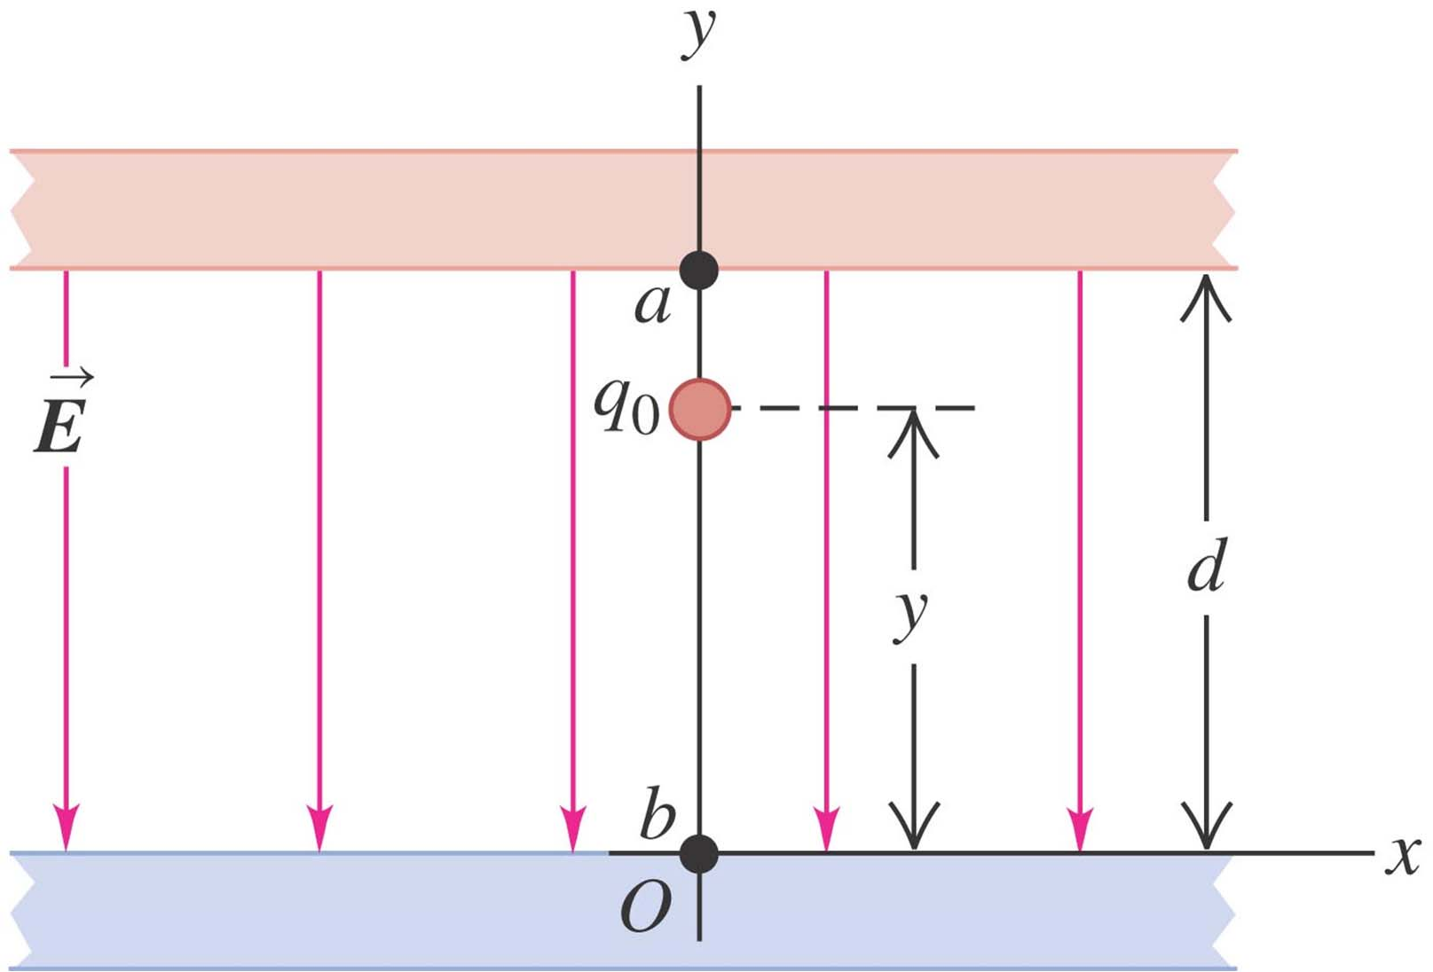
Oppositely charged parallel plates
Follow Example 23.9 using Figure 23.18 below.

Slide 17
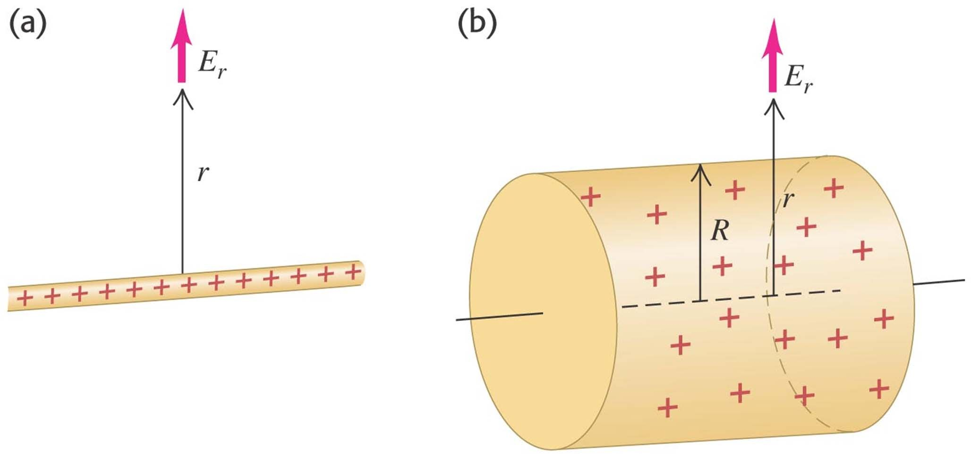
An infinite line charge or conducting cylinder
Follow Example 23.10 using Figure 23.19 below.

Slide 18
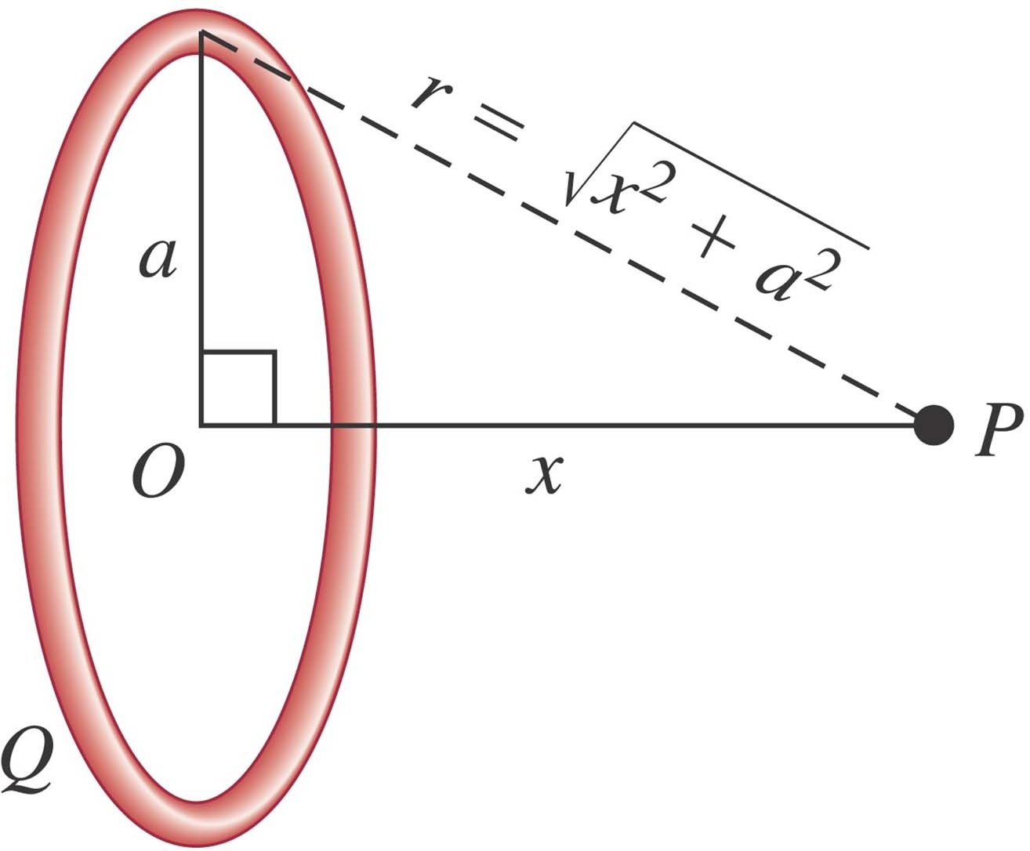
A ring of charge
Follow Example 23.11 using Figure 23.20 below.

Slide 19
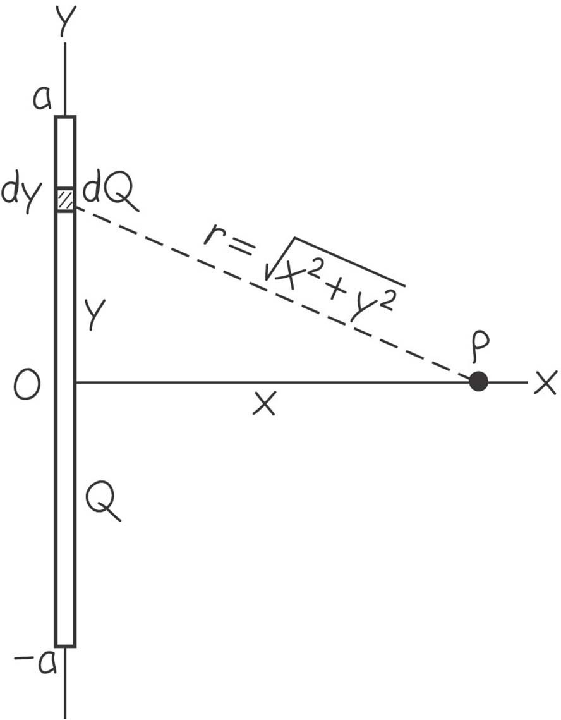
A finite line of charge
Follow Example 23.12 using Figure 23.21 below.

Slide 20
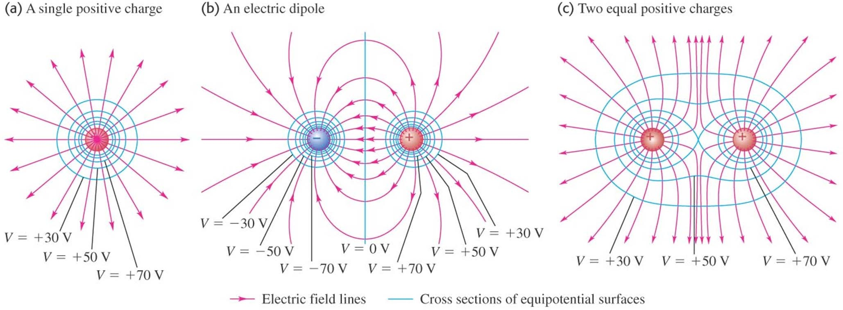
Equipotential surfaces and field lines
An equipotential surface is a surface on which the electric potential is the same at every point.
Figure 23.23 below shows the equipotential surfaces and electric field lines for assemblies of point charges.
Field lines and equipotential surfaces are always mutually perpendicular.

Slide 21
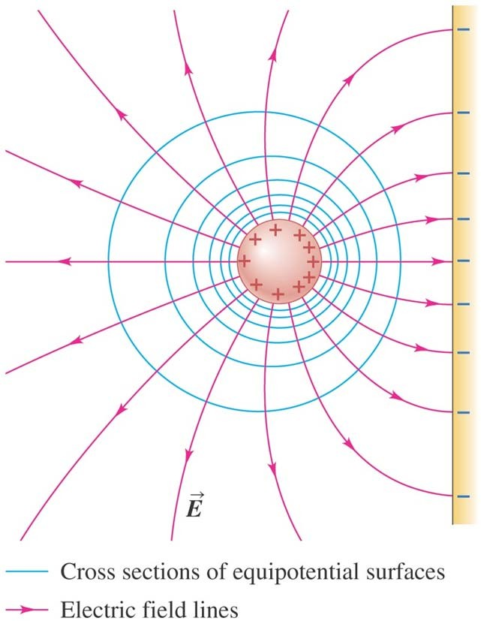
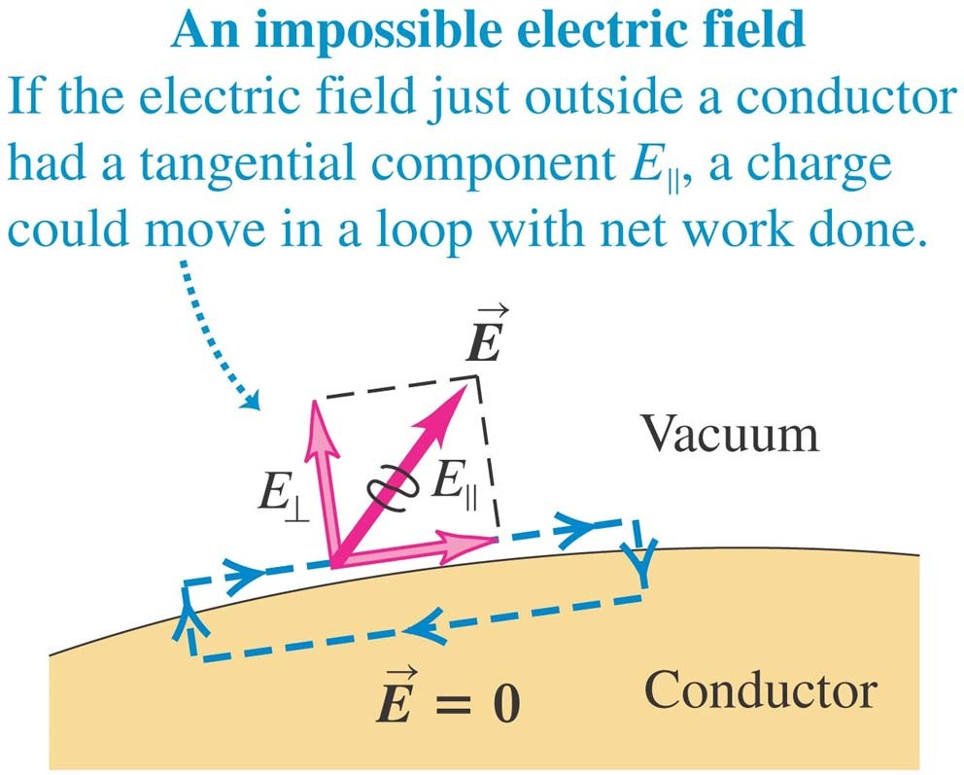
Equipotentials and conductors
When all charges are at rest:
the surface of a conductor is always an equipotential surface.
the electric field just outside a conductor is always perpendicular to the surface (see figures below).
the entire solid volume of a conductor is at the same potential.

Slide 22
Potential gradient
Read in the text the discussion of potential gradient.
Follow Example 23.13 which looks at a point charge.
Follow Example 23.14 which deals with a ring of charge.

